Slide 1
Implicit Objects

Slide 2
JSP Implicit object
In this module we will see below topics
JSP Out
JSP Request
JSP Response
JSP Config
JSP Application
JSP Session
JSP PageContext
JSP Page
JSP Exception

Slide 3
JSP Implicit object
What is JSP Implicit object?
JSP implicit objects are created during the translation phase of JSP to the servlet.
These objects can be directly used in scriplets that goes in the service method.
They are created by the container automatically, and they can be accessed using objects.
There are 9 types of implicit objects available in the container:
out
request
response
config
application
session
pageContext
page
exception

Slide 4
JSP Out Example Duration : 10 min
Lets understand Implicit object with example one by one
Out
Out is one of the implicit objects which is used to write the data to the buffer and send output to the client in response
It allows us to access the servlet's output stream
It is object of javax.servlet.jsp.jspWriter class
When we work with servlet, we need printwriter object
To understand the out object how it works we will see the example in eclipse.
out is used to print into output stream
<%@ page language="java" contentType="text/html; charset=ISO-8859-1“ pageEncoding="ISO-8859-1"%>
<!DOCTYPE html PUBLIC "-//W3C//DTD HTML 4.01 Transitional//EN" "http://www.w3.org/TR/html4/loose.dtd">
<html>
<head>
<meta http-equiv="Content-Type" content="text/html; charset=ISO-8859-1">
<title>Jsp Out example</title>
</head>
<body>
<% int var1=10;int var2=20;
out.println(“var1 is " +var1);
out.println(“var2 is "+var2);
%>
</body>
</html>
After running the above jsp file we will see the following lines on browser.
var1 is10 var2 is20

Slide 5
JSP Request
Request
The request object is an instance of java.servlet.http.HttpServletRequest and it is one of the argument of service method
It is created by container for every request.
It is used to request the information like parameter, header information , server name, etc.
It uses getParameter() to access the request parameter.
To understand the Request object how it works with form we will see the example

Slide 6
JSP Request Example Duration:10 min
Form.jsp
<%@ page language="java" contentType="text/html"%>
<!DOCTYPE html PUBLIC "-//W3C//DTD HTML 4.01 Transitional//EN" "http://www.w3.org/TR/html4/loose.dtd">
<html>
<head>
<meta http-equiv="Content-Type" content="text/html;">
<title>Request Object Example</title>
</head>
<body>
<form action=“login.jsp”>
<input type=“text” name=“username”>
<input type=“submit” value=“submit”>
</form>
</body>
</html>
login.jsp
<%@ page language="java" contentType="text/html"%>
<!DOCTYPE html PUBLIC "-//W3C//DTD HTML 4.01 Transitional//EN" "http://www.w3.org/TR/html4/loose.dtd">
<html>
<head>
<meta http-equiv="Content-Type" content="text/html;"><title>Request Object Form</title>
</head>
<body>
<% String username=request.getParameter(“username”);
out.println(“Welcome”+username);
%>
</form>
</body>
</html>
(form) request is sent and the variable username is processed and sent to login.jsp which is action of JSP.
It is action jsp where the request is processed, and username is taken from form jsp.
When you execute the above code, you get the following output
When you write your name as Sudha and click on the submit button, then you get the following output "Welcome Sudha."

Slide 7
JSP Response object Example Duration:5 min
Response
"Response" is an instance of class which implements HttpServletResponse interface
Container generates this object and passes to _jspservice() method as parameter
"Response object" will be created by the container for each request.
It represents the response that can be given to the client
The response implicit object is used to content type, add cookie and redirect to response page
<%@ page language="java" contentType="text/html"%>
<!DOCTYPE html PUBLIC "-//W3C//DTD HTML 4.01 Transitional//EN" "http://www.w3.org/TR/html4/loose.dtd">
<html>
<head>
<meta http-equiv="Content-Type" content="text/html;">
<title>Response object Example</title>
</head>
<body>
<%response.setContentType("text/html"); %>
</body>
</html>
In the response object we can set the content type
In the above example we set only the content type in the response object. Hence, there is no output for this.

Slide 8
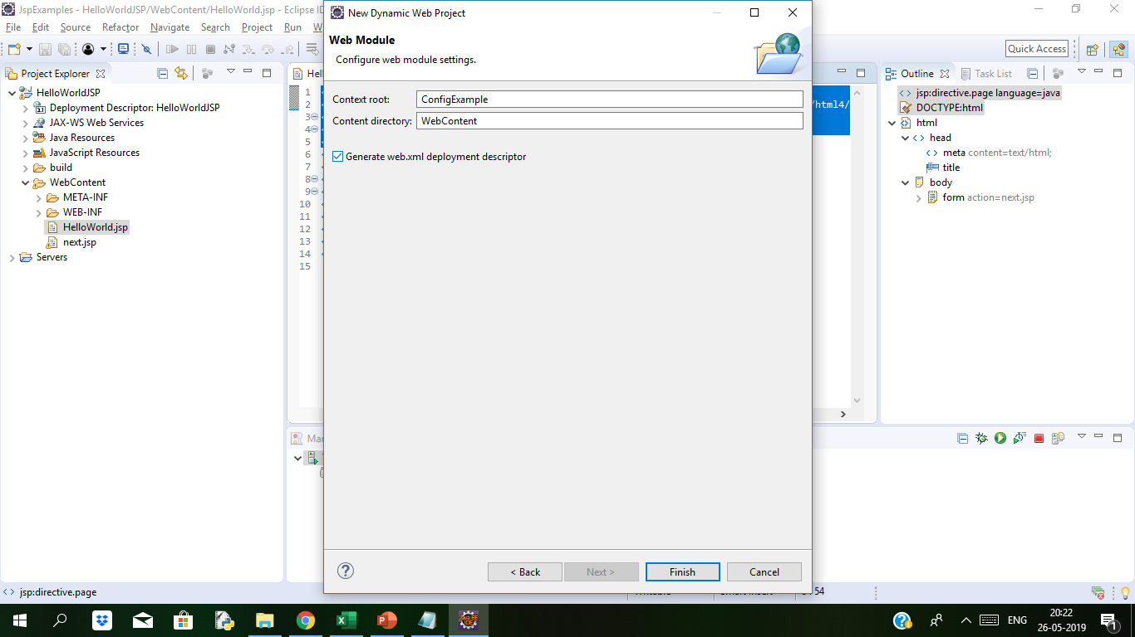
JSP Config object Example Duration: 15 min
Config
"Config" is of the type java.servlet.servletConfig
It is created by the container for each jsp page
It is used to get the initialization parameter in web.xml
To understand config object we will create new dynamic web project in eclipse. While creating the project check generate web.xml check box so it will create web.xml file.
Notes:
Note: Never end an expression with semicolon inside Expression Tag. Like this:
<%= (11*2); %>

Slide 9
JSP Config object Example
<?xml version="1.0" encoding="UTF-8"?>
<web-app xmlns:xsi="http://www.w3.org/2001/XMLSchema-instance" xmlns="http://xmlns.jcp.org/xml/ns/javaee" xsi:schemaLocation="http://xmlns.jcp.org/xml/ns/javaee http://xmlns.jcp.org/xml/ns/javaee/web-app_3_1.xsd" id="WebApp_ID" version="3.1">
<display-name>ConfigExample</display-name>
<servlet>
<description></description>
<display-name>Config</display-name>
<servlet-name>Config</servlet-name>
<servlet-class>test.Config</servlet-class>
</servlet>
<servlet-mapping>
<servlet-name>Config</servlet-name>
<url-pattern>/Config</url-pattern>
</servlet-mapping>
<welcome-file-list>
<welcome-file>index.html</welcome-file>
<welcome-file>index.htm</welcome-file>
<welcome-file>index.jsp</welcome-file>
<welcome-file>default.html</welcome-file>
<welcome-file>default.htm</welcome-file>
<welcome-file>Config.jsp</welcome-file>
</welcome-file-list>
</web-app>
<%@ page language="java" contentType="text/html;"%>
<!DOCTYPE html PUBLIC "-//W3C//DTD HTML 4.01 Transitional//EN" "http://www.w3.org/TR/html4/loose.dtd">
<html>
<head>
<meta http-equiv="Content-Type" content="text/html;">
<title>Config Object Example</title>
</head>
<body>
<% String servletName = config.getServletName();
out.println("Servlet Name is " + servletName);%>
</body>
</html>
After Executing on browser we can see the output as
Servlet Name is Config
Notes:
In web.xml we have mapping of servlets to the classes.
To get the name of the servlet in JSP, we can use config.getServletName, which will help us to get the name of the servlet.

Slide 10
JSP Application object Example Duration: 5 min
Application
Application object is an instance of javax.servlet.ServletContext and it is used to get the context information and attributes in JSP.
Application object is created by container one per application, when the application gets deployed.
Servletcontext object contains a set of methods which are used to interact with the servlet container.We can find information about the servlet container
We will see the below example to understand the application object example
<%@ page language="java" contentType="text/html; charset=ISO-8859-1" pageEncoding="ISO-8859-1"%>
<!DOCTYPE html PUBLIC "-//W3C//DTD HTML 4.01 Transitional//EN" "http://www.w3.org/TR/html4/loose.dtd">
<html>
<head>
<meta http-equiv="Content-Type" content="text/html; charset=ISO-8859-1">
<title>Application Object Example</title>
</head>
<body>
<% out.println(application.getContextPath()); %>
</body>
</html>
We will see the following output when we run on browser.
/ApplicationExample
Notes:
Note: Never end an expression with semicolon inside Expression Tag. Like this:
<%= (11*2); %>

Slide 11
JSP Session object Example Duration: 10 min
Session
The session is holding "httpsession" object.
Session object is used to get, set and remove attributes to session scope and also used to get session information
We will see the example to understand how session object works. Below is form1.jsp
form2.jsp
<%@ page language="java" contentType="text/html; charset=ISO-8859-1"
pageEncoding="ISO-8859-1"%>
<!DOCTYPE html PUBLIC "-//W3C//DTD HTML 4.01 Transitional//EN" "http://www.w3.org/TR/html4/loose.dtd">
<html>
<head>
<meta http-equiv="Content-Type" content="text/html; charset=ISO-8859-1">
<title>Session Object Example</title>
</head>
<body>
<% String name = (String)session.getAttribute("user");
out.println("User Name is " +name);
%>
</body>
</html>
<%@ page language="java" contentType="text/html;"%>
<!DOCTYPE html PUBLIC "-//W3C//DTD HTML 4.01 Transitional//EN" "http://www.w3.org/TR/html4/loose.dtd">
<html>
<head>
<meta http-equiv="Content-Type" content="text/html;">
<title>JSP session object</title>
</head>
<body>
<% session.setAttribute("user","admin"); %>
<a href="form2.jsp">Click here to get user name</a>
</body>
</html>

Slide 12
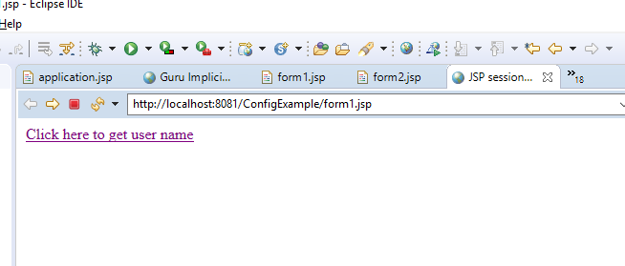
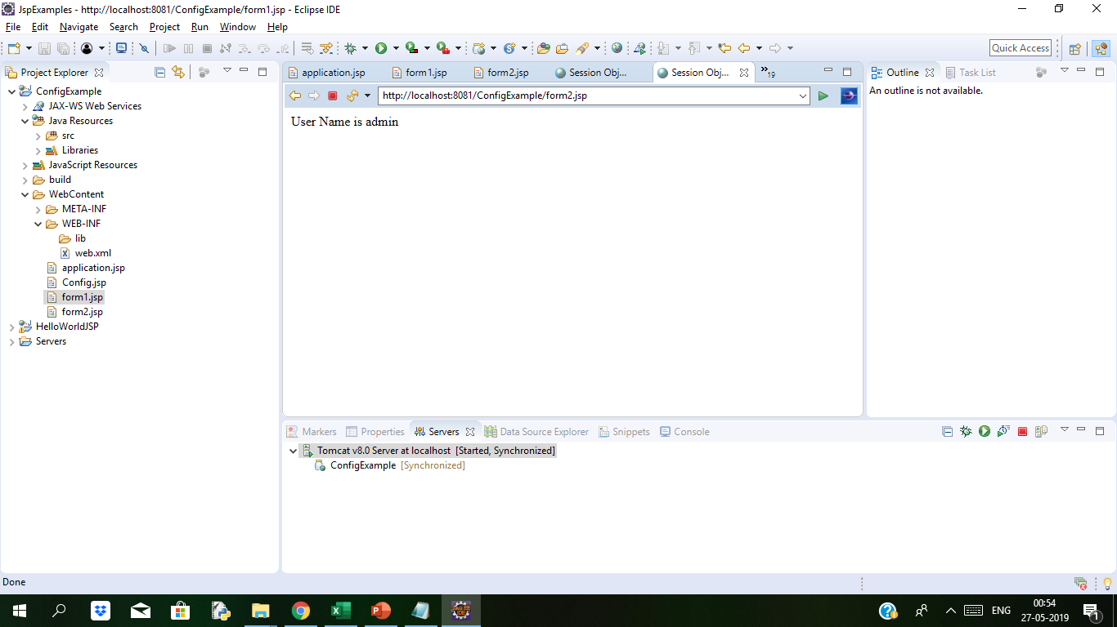
JSP Session object Example Duration:10 min
In form1.jsp we are setting the attribute user in the session variable, and that value can be fetched from the session in whichever jsp is called from that (form2.jsp).
We are getting the value of user attribute from session object and displaying that value
When we run on browser the above code, we get the following output:
We are calling another jsp on href in which we will get the value for attribute user which is set.
form2.jsp
Notes:
When we click on link given in form1.jsp then we are redirected to second jsp page, i.e (form2.jsp) page and we get the value from session object of the user attribute (form1.jsp).

Slide 13
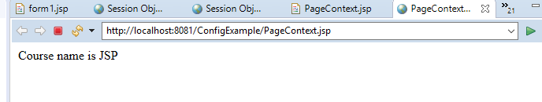
JSP pageContext object Example Duration 5 min
pageContext:
This object is of the type of pagecontext.
It is used to get, set and remove the attributes from a particular scope
Scopes are of 4 types:
Page
Request
Session
Application
we are setting the attribute using pageContext object, and it has three parameters:
Key
Value
Scope
We will observe the example how it works.
In the example the key is course and value is “JSP" while the scope is the page scope. Here the scope is "page" and it can get using page scope only.
We are getting the value of the attribute using pageContext
<%@ page language="java" contentType="text/html; charset=ISO-8859-1"
pageEncoding="ISO-8859-1"%>
<!DOCTYPE html PUBLIC "-//W3C//DTD HTML 4.01 Transitional//EN" "http://www.w3.org/TR/html4/loose.dtd">
<html>
<head>
<meta http-equiv="Content-Type" content="text/html; charset=ISO-8859-1">
<title>PageContextExample</title>
</head>
<body>
<% pageContext.setAttribute("course","JSP",pageContext.PAGE_SCOPE);
String name = (String)pageContext.getAttribute("course");
out.println("Course name is " +name);%>
</body>
</html>
When you execute the above code, you get the following output:
Course name is JSP

Slide 14
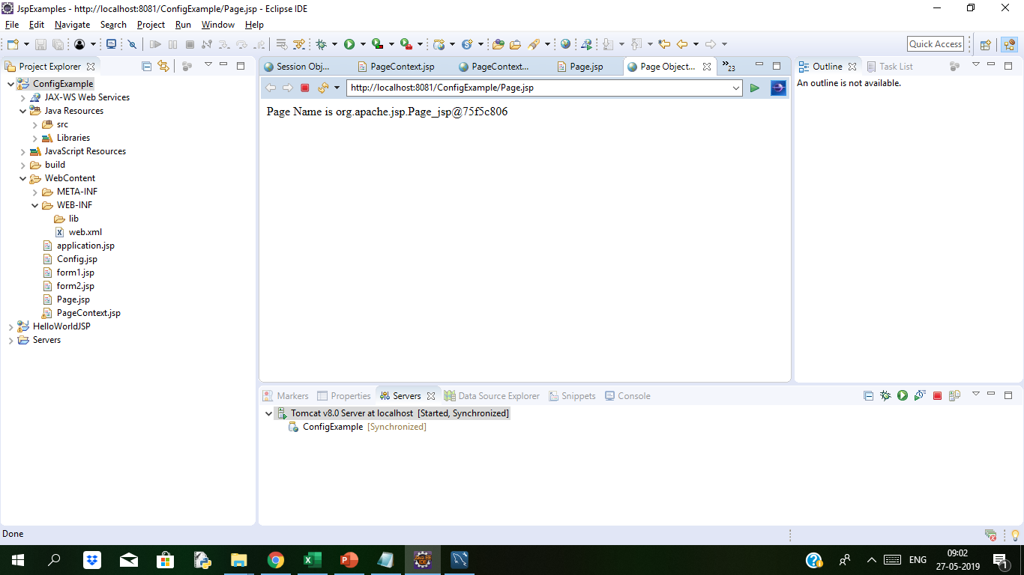
JSP Page Object Example Duration: 5 min
Page
Page implicit variable holds the currently executed servlet object for the corresponding jsp.
Acts as this object for current jsp page..
We will understand now how this Page object works with example
In this example, we are trying to use the method toString() of the page object and trying to get the string name of theJSP Page.
When you execute the code you get the following output:
Output is string name of above jsp page
Page Name is org.apache.jsp.Page_jsp@75f5c806
<%@ page language="java" contentType="text/html; charset=ISO-8859-1"
pageEncoding="ISO-8859-1"%>
<!DOCTYPE html PUBLIC "-//W3C//DTD HTML 4.01 Transitional//EN" "http://www.w3.org/TR/html4/loose.dtd">
<html>
<head>
<meta http-equiv="Content-Type" content="text/html; charset=ISO-8859-1">
<title>Page Object Example</title>
</head>
<body>
<% String pageName = page.toString();
out.println("Page Name is " +pageName);%>
</body>
</html>

Slide 15
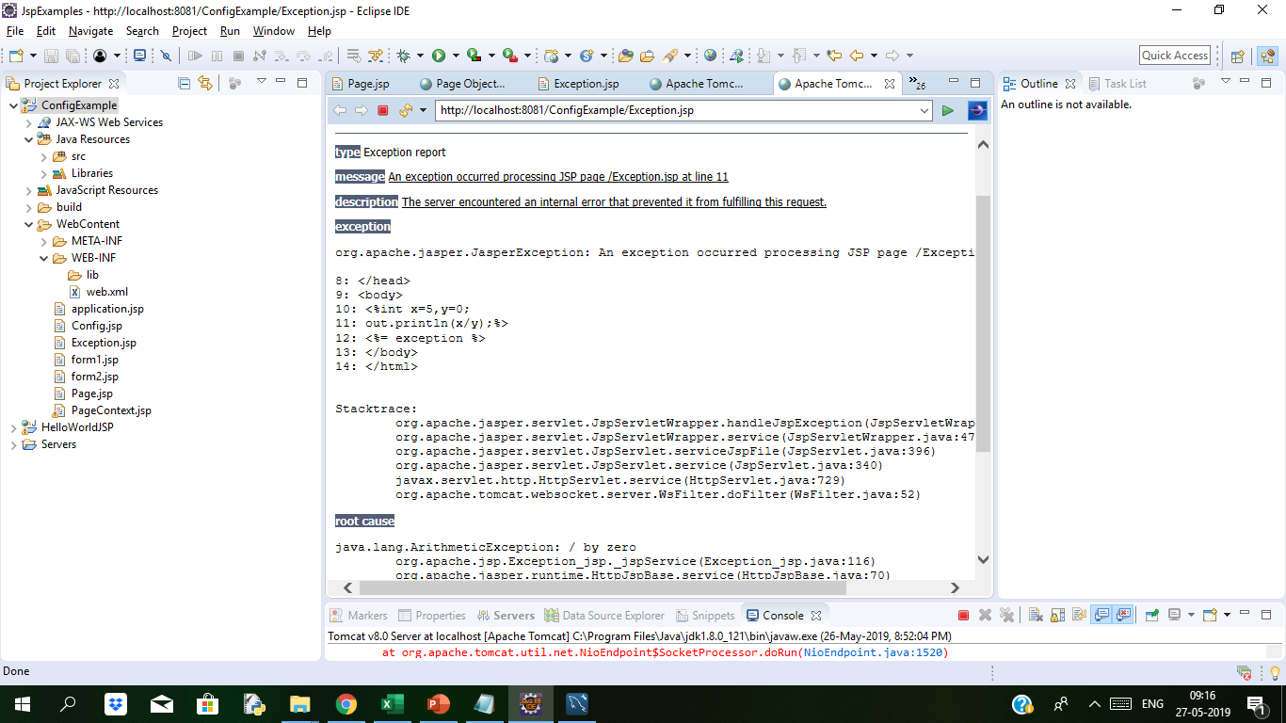
JSP Exception Example Duration: 7min
Exception
Exception is the implicit object of the throwable class.
It is used for exception handling in JSP.
The exception object can be only used in error pages.
We will see the example to elaborate more about exception.
In the below example if we divide by 0 the exception division by zero excpetion is thrown.
Line <%= exception %> is throwing exception
<%@ page language="java" contentType="text/html; charset=ISO-8859-1"
pageEncoding="ISO-8859-1" isErrorPage="true"%>
<!DOCTYPE html PUBLIC "-//W3C//DTD HTML 4.01 Transitional//EN" "http://www.w3.org/TR/html4/loose.dtd">
<html>
<head>
<meta http-equiv="Content-Type" content="text/html; charset=ISO-8859-1">
<title>Exception Example</title>
</head>
<body>
<%int x=5,y=0;
out.println(x/y);%>
<%= exception %>
</body>
</html>

Slide 16

Thank You

